Slide 1
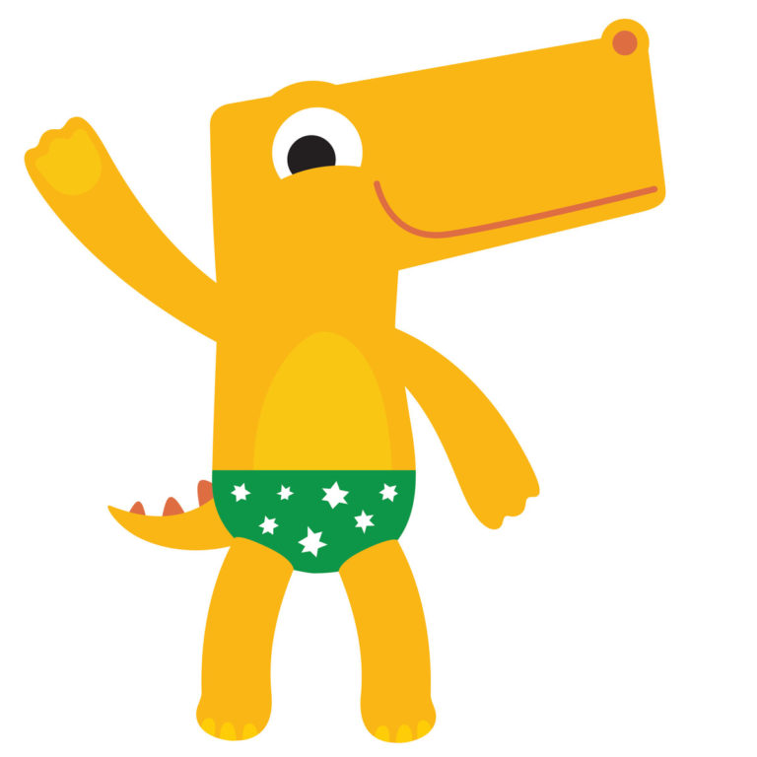
We are now in a PSHEE Lesson
LO: I know which parts of my body are private.

Slide 2
Key Word:
Private Parts
What does this word mean?
Have you heard this word before?
Private parts are the parts covered by a swimsuit or underwear.

Slide 3
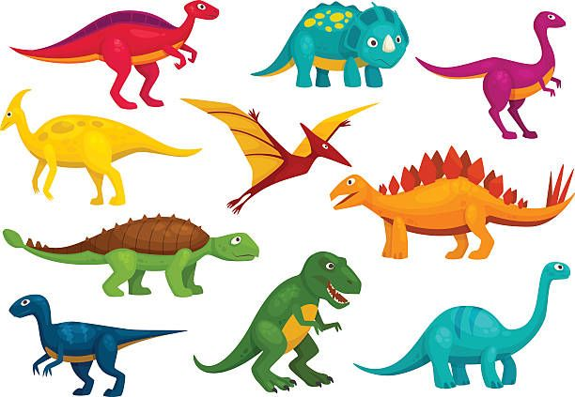
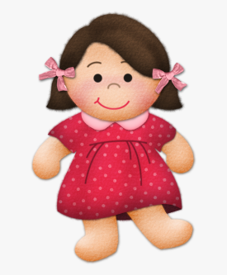
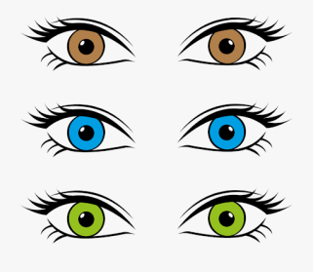
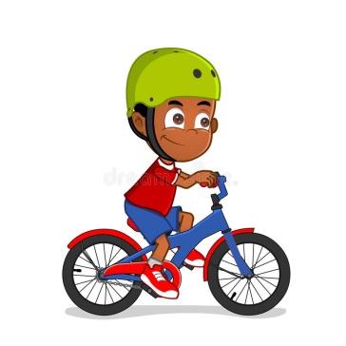

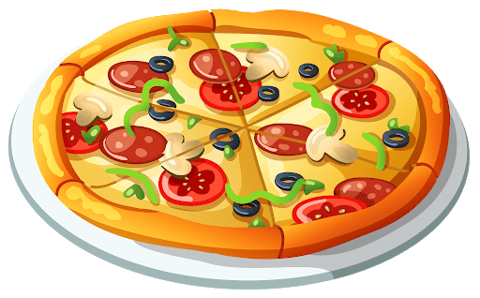
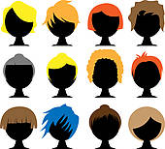
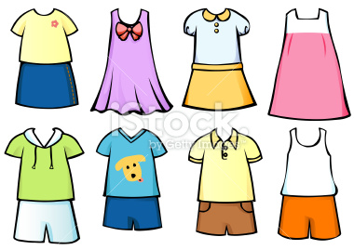
How are we different?
We are different in different ways:
Hair colour
Eye colour
The toys that we like
The food that we like
The clothes we wear
Skin colour
Our interests and hobbies, like riding a bike or swimming.

Slide 4
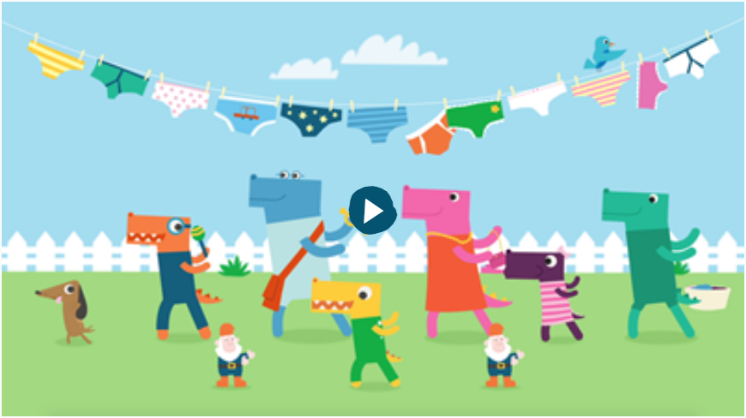
Pantosaurus

Slide 5

What are the Pants rules:
1. Privates are private
2. Always remember that your body belongs to you
3. No means NO
4. Talk about secrets that upset you
5. Speak up and someone can help.

Slide 6
Who can you speak to if you are worried or sad?
Mum or Dad
Someone else at home
Other family members
Teachers

Slide 7
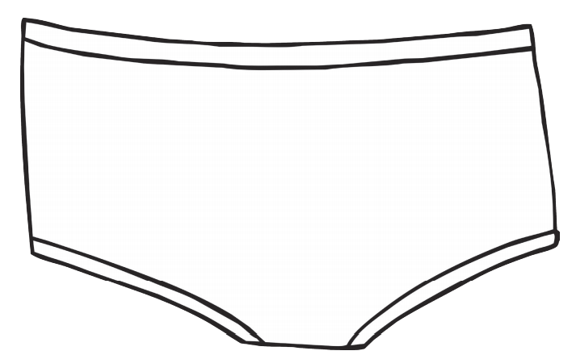
Design a new pair of pants for Pantosaurus!

